Slide 1



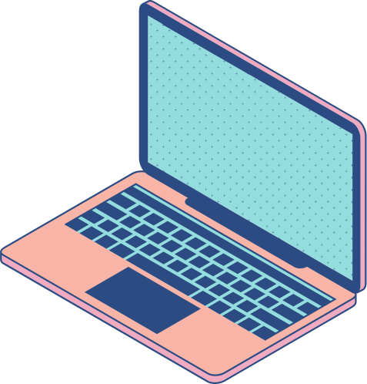

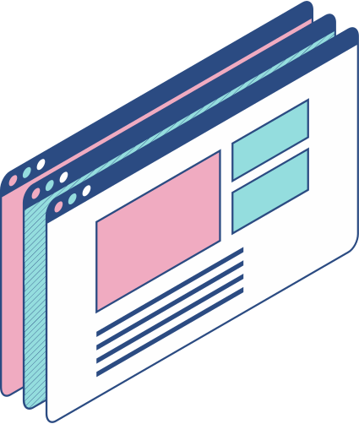
VIRTUAL TALK ON
“UTMDigital – Our Digital University Driver”
A look at the technology of managing data in UTM

Slide 2

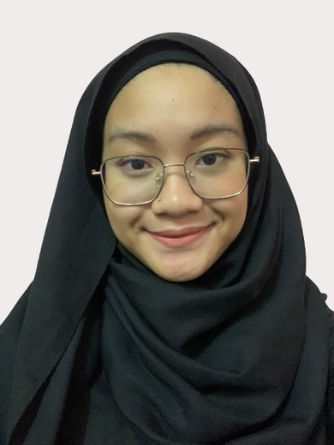
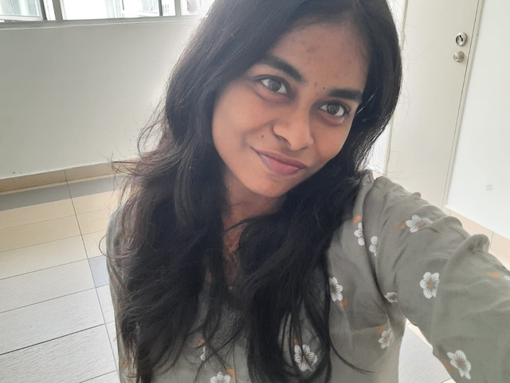
Members
Wan Aishah
A23MJ5044
Eiklil
A23MJ5044
Daneswaary
A23MJ5049
We are from 1st year Software Engineering students
from Section 15, (Malaysia-Japan International Institute Technology [MJIIT]

Slide 3

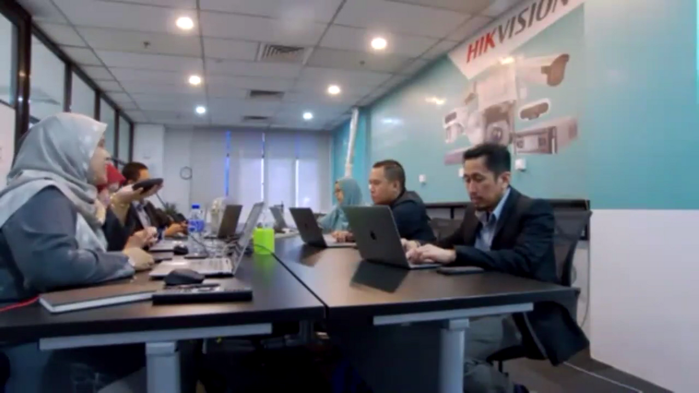
UTM Digital
ORGANIZATION WE’VE VISITED VIA RECORDED TALK ON WEBEX ABOUT 396 STUDENTS JOINED THE LIVE TALK ARE FROM UTM SKUDAI

Slide 4
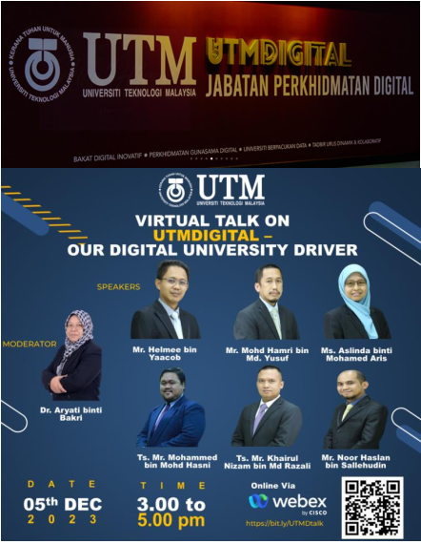


Positions
Division of Digital Innovation
Division of Digital Architecture
Division of Infrastructure Architecture
Division of Strategic Architecture

Slide 5
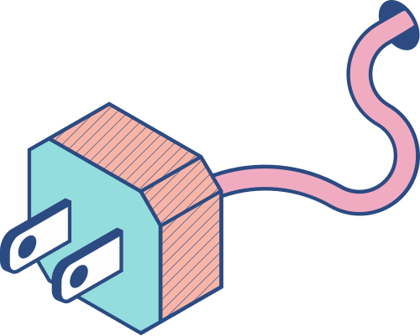

Overview of the Program
The talk was on 5th December 2023 and we watched it live on Webex using our laptops in college since the event was held at UTM Skudai. It started at 3:00 p.m and ended slight earlier than 5:00 p.m. The talk was about the job scope of UTM Digital in managing our data.

Slide 6
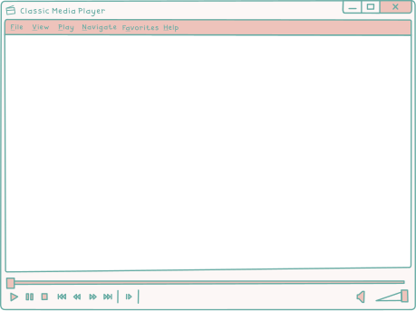
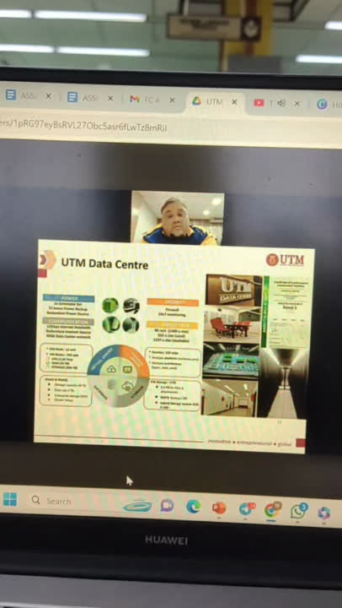
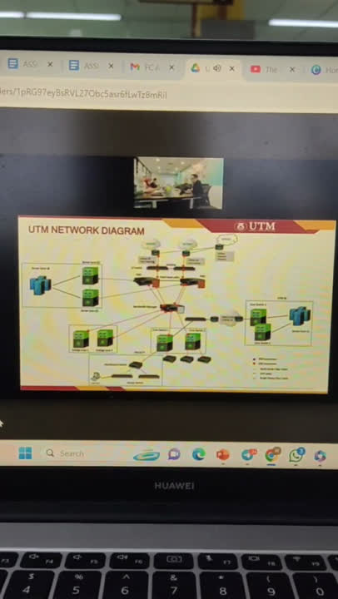
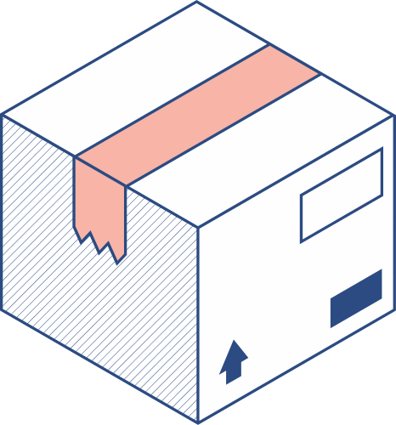


Glance of recording
Division of Digital
Infrastructure
Division of Digital
Architecture

Slide 7
About UTM Digital | Core Function
Vision: Digital University Driver Mission: Strengthening the delivery of academic-oriented services through a data-driven digital ecosystem The construction of UTM Data Centre started on March 2017-2019 Get TIA-92 recognition, Certificate of Conformance Constructed Facilities Rated 3 on November 2019 | Develop and implement new applications and upgrade existing applications that cover the core business of the University Ensure that ICT infrastructure is always available to support the application platform developed Support the implementation of Digital Lifestyles through development of latest innovation technology

Slide 8
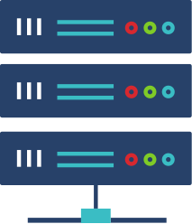
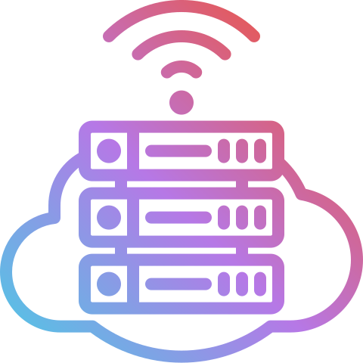


What we’ve learned from UTM Data Centre
Virtual Server Power: 72 hours Power Backup Communication: 12Gbps Internet Bandwidth Database Oracle & MySQL Data size: 4 TB | Physical server Security: Firewall that monitors 24/7 Multiple platforms such as Windows and Unix Storage File storage: 2PB Hybrid Storage System SCSI & SSD

Slide 9
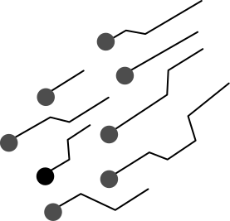
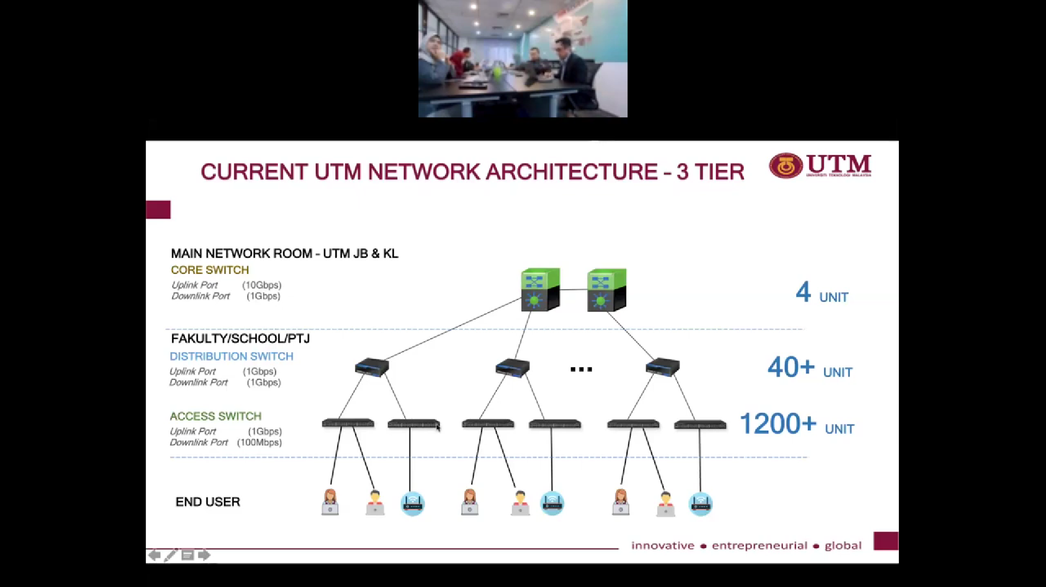
What we’ve learned from UTM Network Architecture

Slide 10
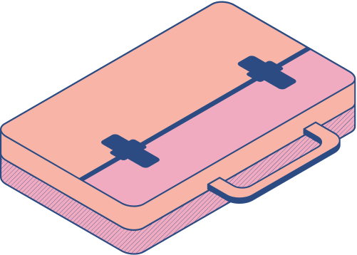


What we’ve learned from UTM Network Security
Correlate with NGAF Correlated block attacker IP Access Control Setting Block any attack from internet (outside) to internal network Correlate with Identity and Access Management [IAM] Surfing Risk Reminder Account lockout | Correlate with Endpoint Compromised host quarantine Access control setting Process Forensics Full host scanning, verification/isolation/removal of malware Protect and remove all malware and attack at server farm

Slide 11


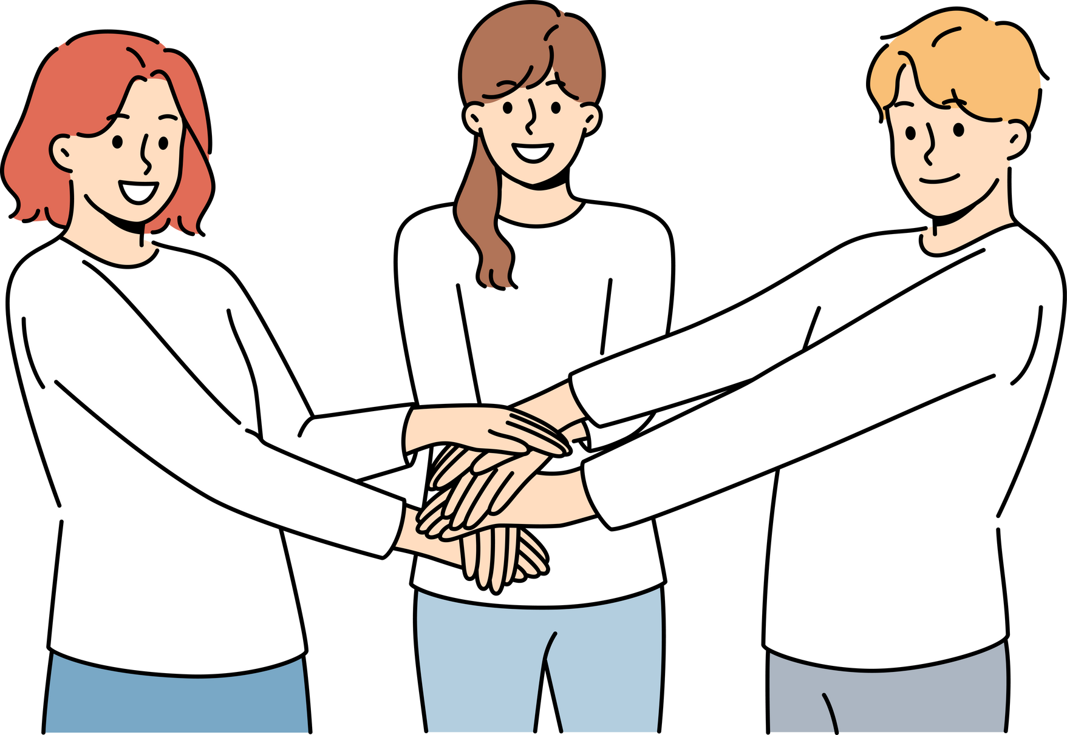
Comprehensive overview of UTM’s digital services and infrastructure
2. Students learned about crucial aspect (ex: student ID acquisition, Microsoft 365 suite access and internet security)
CONCLUSION
3. Students gained practical knowledge applicable in academics and professional settings
4. Understanding of digital technologies and their applications, contributing to their academic and professional growth.

Slide 12



JUSTIFICATIONS
Informative and Beneficial
Understanding Infrastructure
Practical Insight
Internet Security and Cyber Command Operations
Project Management and Application Development
Exposure to Industry Practices

